Slide 1
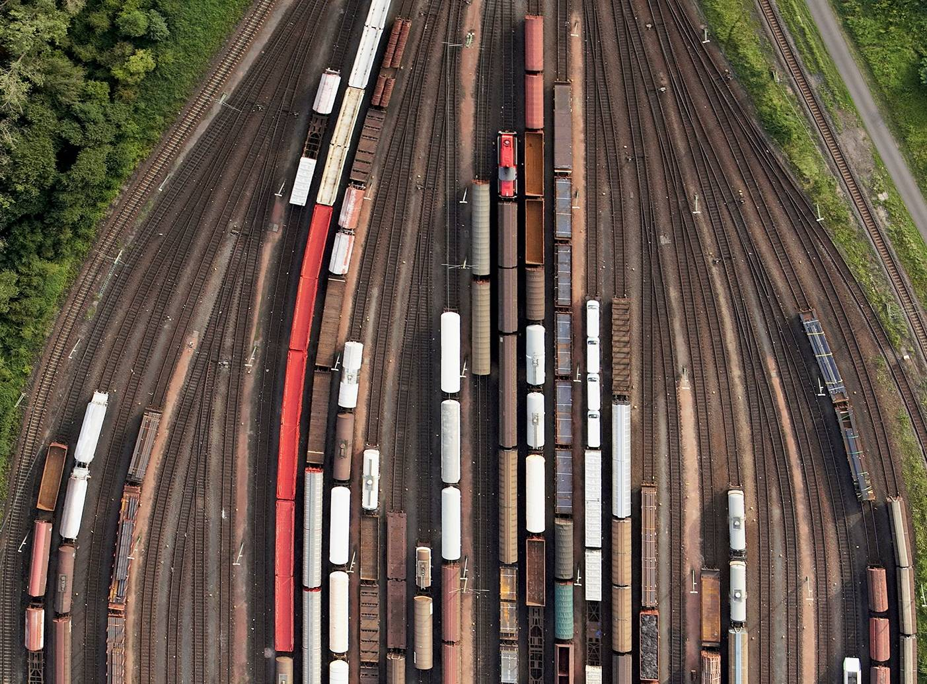



CHAPTER 1: INTRODUCTION TO DATA INTEGRATION
PRINCIPLES OF
DATA INTEGRATION
ANHAI DOAN ALON HALEVY ZACHARY IVES

Slide 2
Outline
Introduction: data integration as a new abstraction
Examples of data integration applications
Schema heterogeneity
Goal of data integration, why it’s a hard problem
Data integration architectures

Slide 3
Data Integration
Databases are great: they let us manage huge amounts of data
  Assuming you’ve put it all into your schema.
In reality, data sets are often created independently
  Only to discover later that they need to combine their data!
  At that point, they’re using different systems, different schemata and have limited interfaces to their data.
The goal of data integration: tie together different sources, controlled by many people, under a common schema.

Slide 4
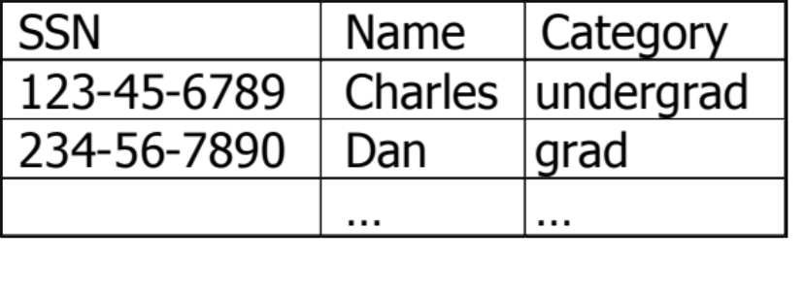
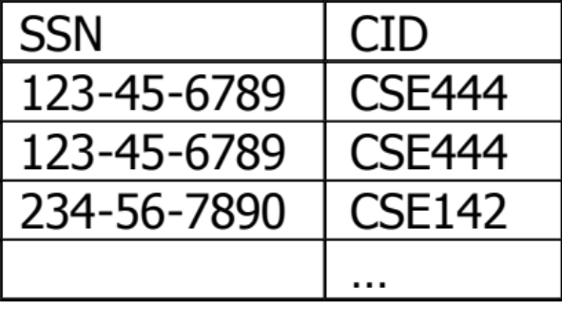
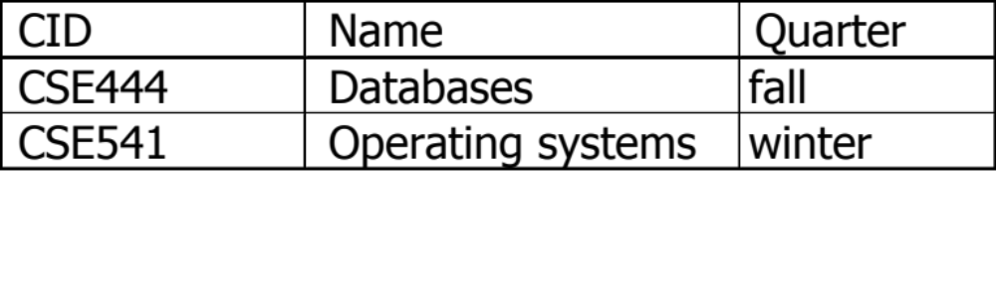
DBMS: it’s all about abstraction
Logical vs. Physical; What vs. How.
Students:
Takes:
Courses:
SELECT C.name
FROM Students S, Takes T, Courses C
WHERE S.name=“Mary” and
S.ssn = T.ssn and T.cid = C.cid

Slide 5
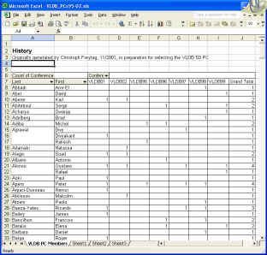

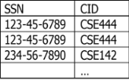

Data Integration:
A Higher-level Abstraction
Query
Independence of:
source & location
data model, syntax
semantic variations
…
Mediated Schema
Semantic
Mappings
S1
S2
S3
…
<cd> <title> The best of … </title>
  <artist> Carreras </artist>
  <artist> Pavarotti </artist>
  <artist> Domingo </artist>
  <price> 19.95 </price>
  </cd>
…

Slide 6
Outline
Introduction: data integration as a new abstraction
Examples of data integration applications
Schema heterogeneity
Goal of data integration, why it’s a hard problem
Data integration architectures

Slide 7
Applications of Data Integration
Business
Science
Government
The Web
Pretty much everywhere

Slide 8

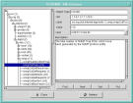
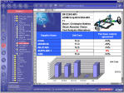
Application Area 1: Business
Enterprise Databases
EII Apps:
CRM
ERP
Portals
…
Single Mediated View
Legacy Databases
Services and Applications
50% of all IT $$$ spent here!

Slide 9





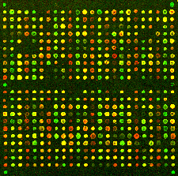
Application Area 2: Science
Phenotype
Gene
Sequenceable Entity
Structured Vocabulary
Experiment
Nucleotide Sequence
Microarray Experiment
Protein
OMIM
HUGO
Swiss-
Prot
GO
Gene-
Clinics
Locus-
Link
Entrez
GEO
Hundreds of biomedical data sources available; growing rapidly!
Notes:
Shown query is courtesy of Hao Mei.
For all phenotypes in one database, find all gene, locus, product triples (GeneTests’ curator query).
For a given genetic disease, find all other diseases caused by the same gene (Joyce Mitchell, National Library of Medicine).
For a set of genes and proteins, find all matches (Marianne Barrier).
For some gene, find all homologues in other species (me).
Notes: Phenotype can be normal (as depicted) or abnormal (gross). Gene is misrepresented as a more concrete chromosome. Vocabulary picture stolen from Unified Medical Language System.

Slide 10


















Application Area 3: The Web

Slide 11
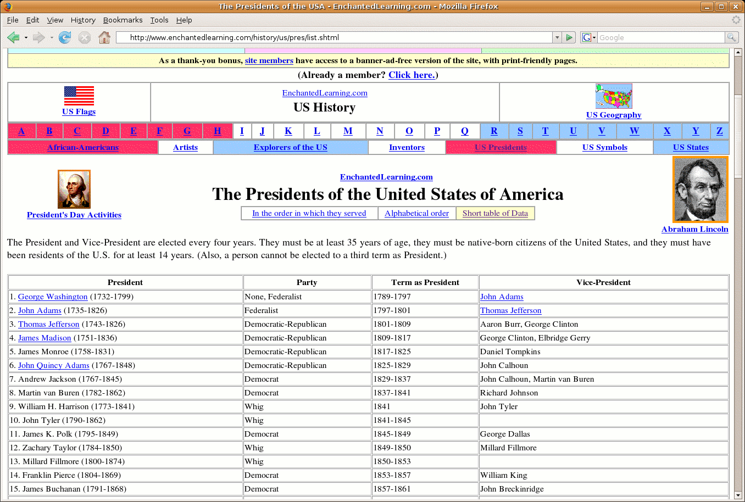
Hundreds of millions of high-quality tables on the Web
Notes:
This unstructured page clearly contains a database. Tuple-oriented, typed columns that represent attributes, and column labels
It also contains tables that are not databases at all.

Slide 12
The Deep Web
Millions of high quality HTML forms out there
Each form has its own special interface
  Hard to explore data across sites.
Goal (for some domains):
  A single interface into a multitude of deep-web sources.

Slide 13
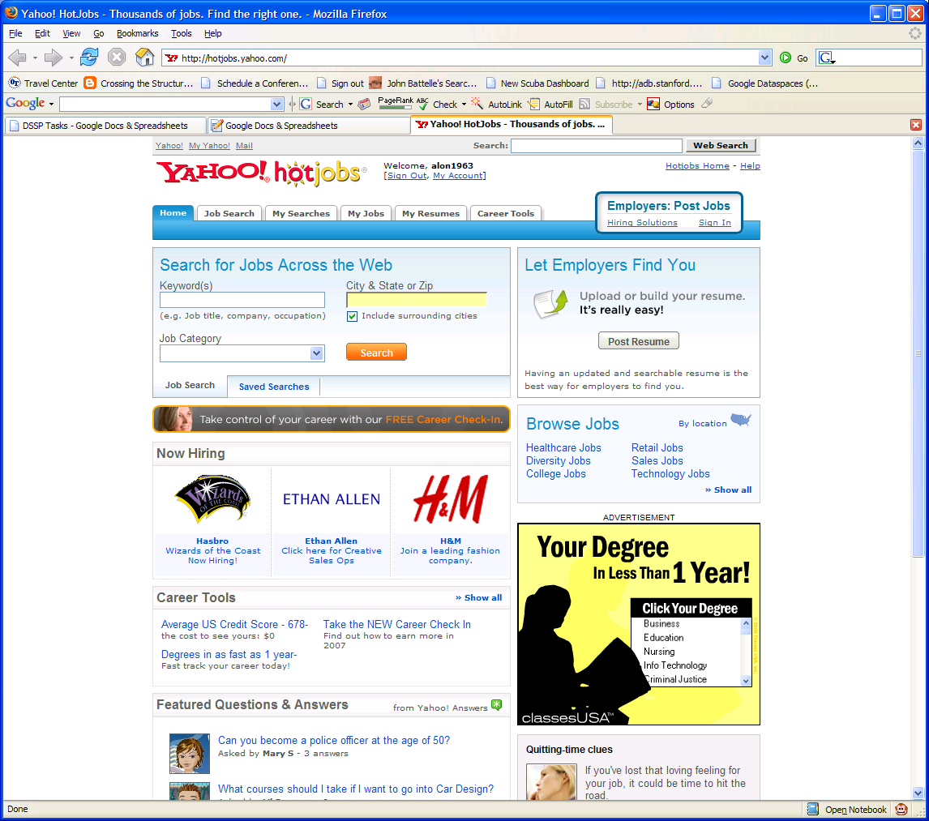
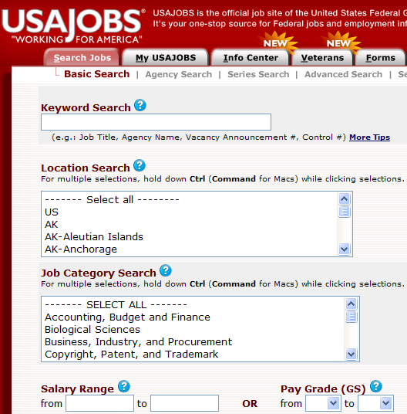
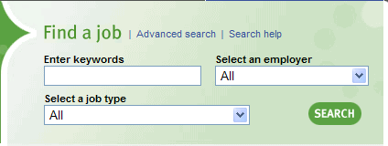

Slide 14
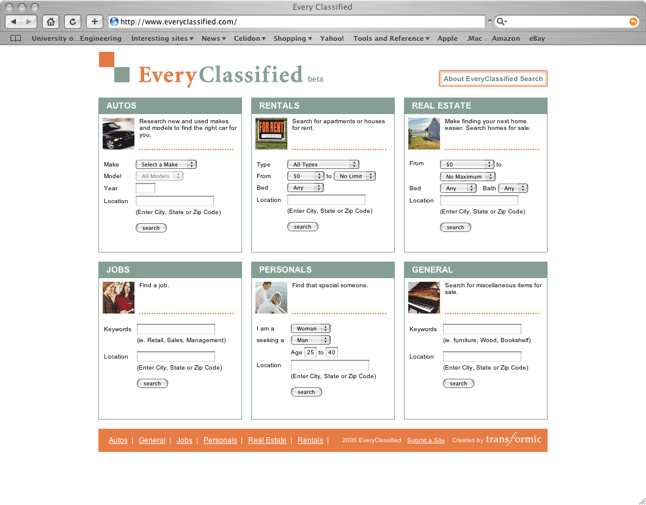
Create a single site to search for jobs/rentals/…

Slide 15
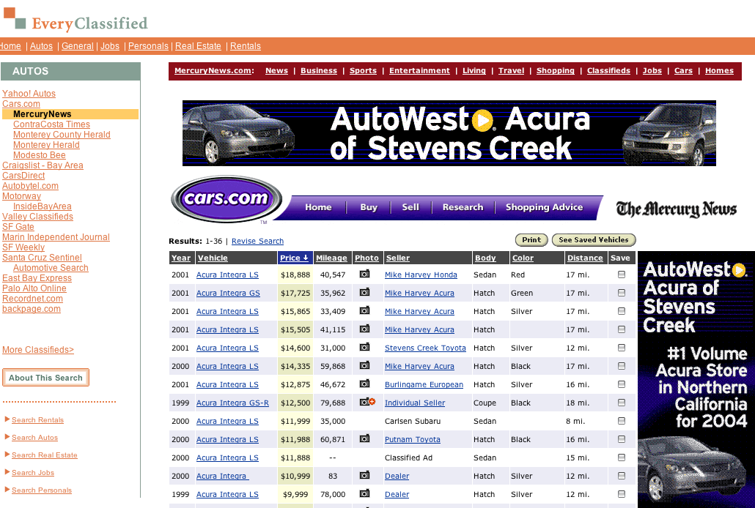
Easily traverse between the site by clicking its name

Slide 16
Outline
Introduction: data integration as a new abstraction
Examples of data integration applications
Schema heterogeneity
Goal of data integration, why it’s a hard problem
Data integration architectures

Slide 17
Enterprise Data Integration:
FullServe Corporation
Employees
Resumes
FullTimeEmp
Hire
TempEmployees
Interview
CV
Training
Services
Services
Customers
Contracts
Courses
Enrollments
Sales
HelpLine
Products
Sales
Calls

Slide 18
EuroCard Corporation
Employees
Resumes
Employees
Hire
Interview
Credit Cards
HelpLine
Customer
CustDetail
Calls

Slide 19
Examples of Heterogeneity
FullServe
EuroCard
FullTimeEmp
ssn, empId, firstName
middleName, lastName
Hire
empId, hireDate, recruiter
TempEmployees
ssn, hireStart, hireEnd
Employees
ID, firstNameMiddleInitial,
lastName
Hire
ID, hireDate, recruiter
Find all employees (making over $100K)

Slide 20
Customer Call Center
Agents should have a full view of customer when they call in.
Sales
Credit Cards
Products
Sales
Customer
CustDetail
Services
Services
Customers
Contracts

Slide 21
Other Reasons to Integrate Data
Create a (useful) web site for tracking services
Collaborate with third parties
  E.g., create branded services
Comply with government regulations
  Find “risky” employees
Business intelligence
  What’s really wrong with our products?

Slide 22
Outline
Introduction: data integration as a new abstraction
Examples of data integration applications
Schema heterogeneity
Goal of data integration, why it’s a hard problem
Data integration architectures

Slide 23
Goal of Data Integration
Uniform query access to a set of data sources
Handle:
  Scale of sources: from tens to millions
  Heterogeneity
  Autonomy
  Semi-structure

Slide 24
Why is it Hard?
Systems-level reasons:
  Managing different platforms
  SQL across multiple systems is not so simple
  Distributed query processing
Logical reasons:
  Schema (and data) heterogeneity
‘Social’ reasons:
  Locating and capturing relevant data in the enterprise.
  Convincing people to share (data fiefdoms)
    Security, privacy and performance implications.

Slide 25
Setting Expectations
Data integration is AI-Complete.
  Completely automated solutions unlikely.
Goal 1:
  Reduce the effort needed to set up an integration application.
Goal 2:
  Enable the system to perform gracefully with uncertainty (e.g., on the web)

Slide 26
Data Integration Smorgasbord
Something for everyone:
  Theory of modeling data sources
  Systems aspects of data integration
  Architectural issues: e.g., P2P data sharing
  AI @ work: automated schema matching
  Web: latest on data integration & web
  Commercial products: BEA, IBM
  Semantic Web: what does it have to offer?
  New trends in DBMS: uncertainty, dataspaces

Slide 27
Outline
Introduction: data integration as a new abstraction
Examples of data integration applications
Schema heterogeneity
Goal of data integration, why it’s a hard problem
Data integration architectures

Slide 28
Virtual, Warehousing and in Between
Data warehousing: integrate by bringing the data into a single physical warehouse
Virtual data integration: leave the data at the sources and access it at query time.
Some differences, but semantic heterogeneity arises in both cases.
Numerous intermediate architectures.
The course illustrates data integration technology mostly through the virtual architecture.

Slide 29
Virtual Data Integration Architecture
Mediated Schema
Query reformulation
or Warehouse
/
Query over materialized data
Source
descriptions
/
Transforms
Wrapper
/
Wrapper
/
Wrapper
/
Wrapper
/
Extractor
Extractor
Extractor
Extractor
RDBMS
1
RDBMS
2
HTML
1
XML
1
Notes:
The one-slide overview of data integration.
You start with a bunch of sources. These can be forms on the web; databases in an enterprise; collections of data in a big science project, or databases in the military or government. They can also be truck parts for a major truck company.
You build wrappers. Won’t talk much about those. But then you put the semantic mappings. These things tell you the relationships between the schemas of the sources and those of the mediated schema. They’re often called ‘source descriptions’ too.
At run-time, you precede the optimization and execution by a reformulation step. That’s when you use the source descriptions to take the query from the mediated schema, decide which sources are relevant, and pose appropriate queries on the sources, and combine the results appropriately.

Slide 30
Example
Movie
(
title
,
director
,
year
,
genre
)
Actors
(
title
,
actor
)
Plays
(
movie
,
location
,
startTime
)
Reviews
(
title
,
rating
,
description
)
S
1
S
2
S
3
S
4
S
5
CinemasInNYC
CinemasInSF
Reviews
Movies
Cinemas
(
title
,
(
name
,
(
place
,
actors
,
director
,
movie
,
start
)
(
cinema
,
title
,
(
location
,
movie
,
date
,
grade
,
startTime
)
startingTime
genre
)
)
review
)
Notes:
The one-slide overview of data integration.
You start with a bunch of sources. These can be forms on the web; databases in an enterprise; collections of data in a big science project, or databases in the military or government. They can also be truck parts for a major truck company.
You build wrappers. Won’t talk much about those. But then you put the semantic mappings. These things tell you the relationships between the schemas of the sources and those of the mediated schema. They’re often called ‘source descriptions’ too.
At run-time, you precede the optimization and execution by a reformulation step. That’s when you use the source descriptions to take the query from the mediated schema, decide which sources are relevant, and pose appropriate queries on the sources, and combine the results appropriately.

Slide 31
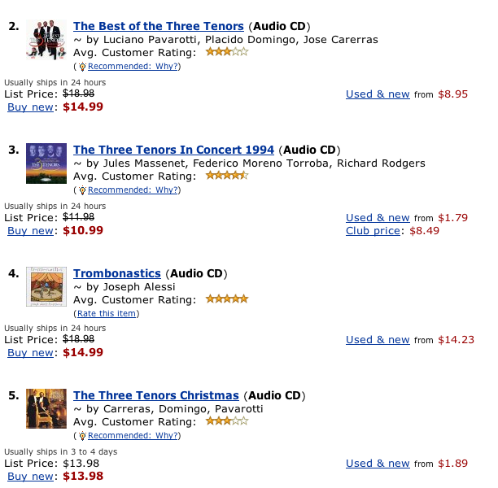
Wrappers
<cd> <title> The best of … </title>
  <artist> Abiteboul </artist>
  <artist> Pavarotti </artist>
  <artist> Domingo </artist>
  <price> 19.95 </price>
  </cd>
  …
Send queries to data sources and transform answers into tuples (or other internal data model). (Chapter 9)

Slide 32
Mediation Languages
Mediated Schema
Describe relationships between mediated schema and data sources
(Chapter 3).
CD: ASIN, Title, Genre,…
Artist: ASIN, name, …
logic
CDs
Album
ASIN
Price
DiscountPrice
Studio
Books
Title
ISBN
Price
DiscountPrice
Edition
Authors
ISBN
FirstName
LastName
Artists
ASIN
ArtistName
GroupName
CDCategories
ASIN
Category
BookCategories
ISBN
Category

Slide 33
Woody Allen Comedies in NY
Mediated schema:
Movie: Title, director, year, genre
Actors: title, actor
Plays: movie, location, startTime
Reviews: title, rating, description
select title, startTime
from Movie, Plays
where Movie.title=Plays.movie AND
location=“New York” AND
director=“Woody Allen”

Slide 34
Movie: Title, director, year, genre
Actors: title, actor
Plays: movie, location, startTime
Reviews: title, rating, description
select title, startTime
from Movie, Plays
where Movie.title=Plays.movie AND
location=“New York” AND
director=“Woody Allen”
Sources S1 and S3 are relevant, sources S4 and S5 are irrelevant, and source S2 is relevant but possibly redundant.
S1
S2
S3
S4
S5
Movies:
name, actors,
director, genre
Cinemas:
place, movie,
start
Cinemas in NYC:
cinema, title,
startTime
Cinemas in SF:
location, movie,
startingTime
Reviews:
title, date
grade, review
Notes:
The one-slide overview of data integration.
You start with a bunch of sources. These can be forms on the web; databases in an enterprise; collections of data in a big science project, or databases in the military or government. They can also be truck parts for a major truck company.
You build wrappers. Won’t talk much about those. But then you put the semantic mappings. These things tell you the relationships between the schemas of the sources and those of the mediated schema. They’re often called ‘source descriptions’ too.
At run-time, you precede the optimization and execution by a reformulation step. That’s when you use the source descriptions to take the query from the mediated schema, decide which sources are relevant, and pose appropriate queries on the sources, and combine the results appropriately.

Slide 35
Query Processing
Query reformulation
Query
Logical query plan
Chapter 8
Query optimizer
Physical query plan
Execution engine
Replanning request
wrapper
wrapper
wrapper
wrapper
wrapper
source
source
source
source
source

Slide 36
Data Warehouses – Offline Replication
Determine physical schema
Define a database with this schema
Define procedural mappings in an “ETL tool” to import the data and clean it.
Periodically copy all of the data from the data sources
  Note that the sources and the warehouse are basically independent at this point
Query
Results
Data Warehouse

Slide 37
Pros and Cons of Data Warehouses
Need to spend time to design the physical database layout, as well as logical
  This actually takes a lot of effort!
Data is generally not up-to-date (lazy or offline refresh)
Queries over the warehouse don’t disrupt the data sources
Can run very heavy-duty computations, including data mining and cleaning

Slide 38
Summary of Chapter 1
Data integration: abstract away the fact that data comes from multiple sources in varying schemata.
Problem occurs everywhere: it’s key to business, science, Web and government.
Goal: reduce the effort involved in integrating.
Regardless of the architecture, heterogeneity is a key issue.
Architectures range from warehousing to virtual integration.

